Slide 1
Look Boss, No Hands:
Fall Term Progress Report
Group 9
Brandon Dring, Carl Benson, Nipun Bathini

Slide 2
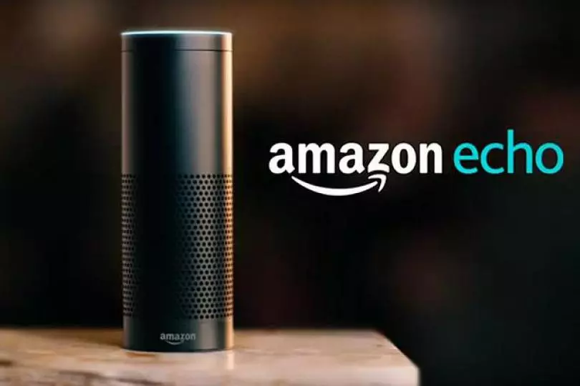
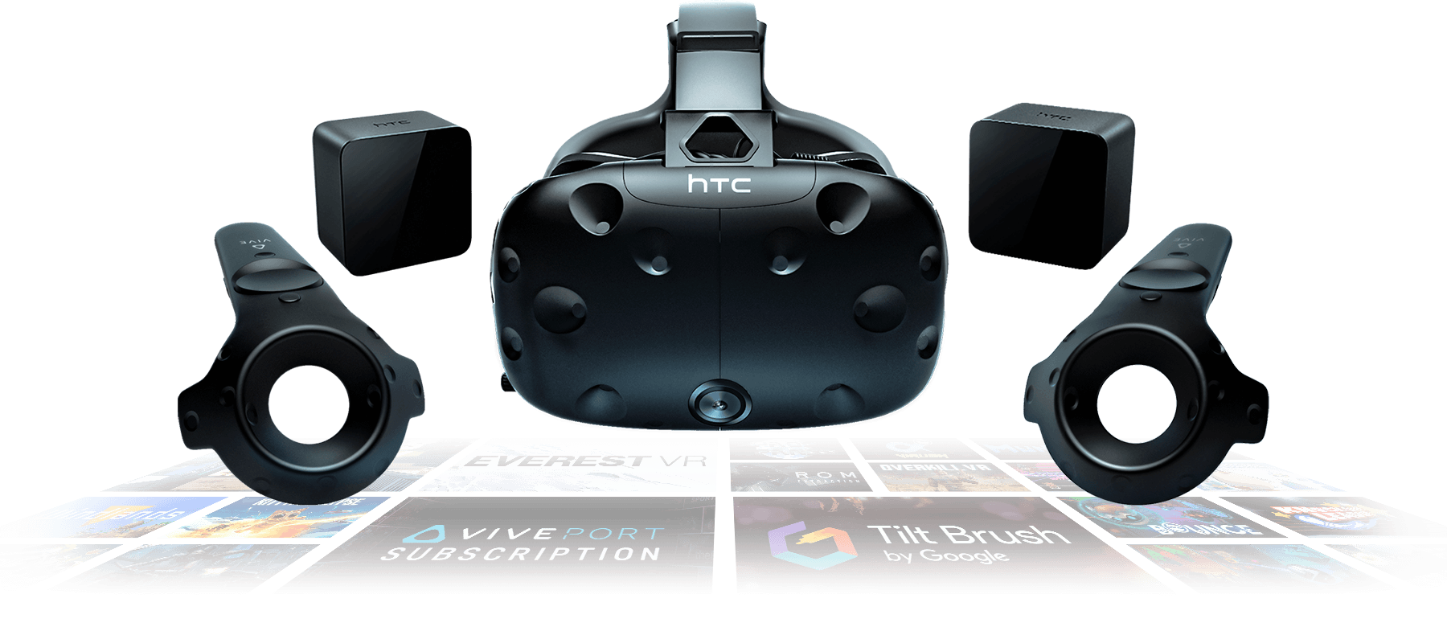
Photo: HTC
Photo: Amazon

Slide 3
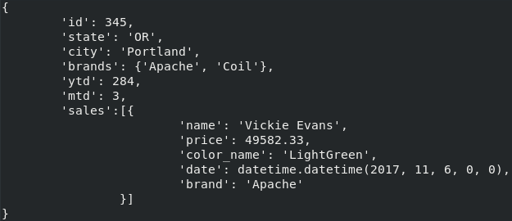
Where are we now?
We have created a skeleton of the project
Workable environment in VR
Setup AWS stuff to host the project
Made and tested simple Alexa Skills
Database
Zenhub
Wearables

Slide 4
VR Headset: HTC Vive
Head and location tracking
Low cost
Open development platform
Natively supported by the Unity engine

Slide 5
Graphic Engine: Unity
Written in C#
.Net framework support
Beginner friendly development
Create for multiple system types

Slide 6
Unity and VR: VRTK
Free
Allows cross compatibility with multiple VR headsets without additional fuss
Extensive documentation

Slide 7

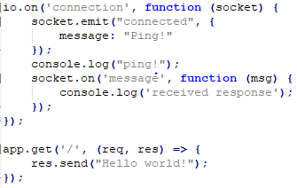
Network Communication: Websockets
Make connections simple
Event based messages
Efficient
Cross-compatible

Slide 8
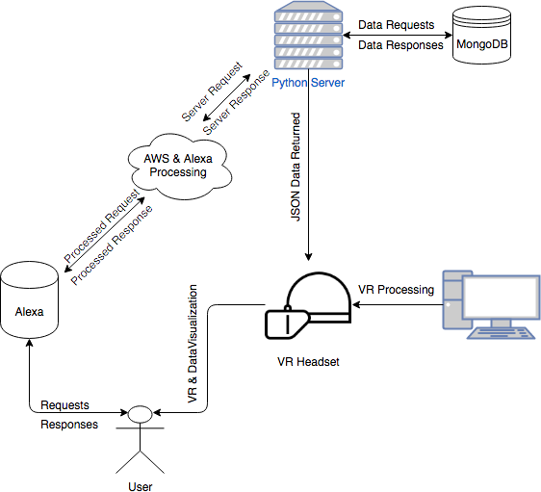
Amazon AWS: EC2 hosting
Reliable, easy to configure cloud hosting, integrates well with other AWS services.
Hosts remote server to access database and fetch necessary data
Shared SSH key between team members to alter anything on cloud server
Best of all, free for 12 months!

Slide 9
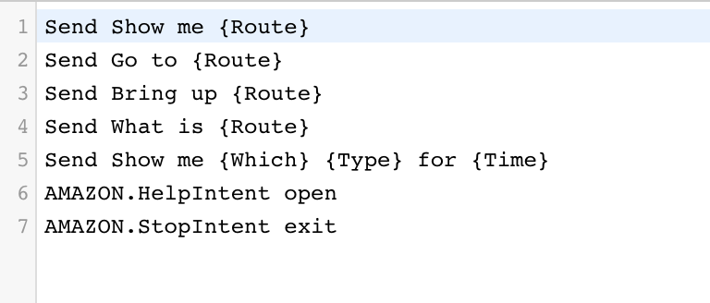
Amazon AWS: Alexa Skills
Near best language processing used.
Processes the most correct words no matter annunciation
Extremely easy to setup and modify
Create speech variable and example phrases that could be used

Slide 10
Amazon AWS: Alexa intent processing
Hosted by AWS Lambda services
Processed in Node.JS
Connects easily with Alexa skill development
Test locally on Alexa, or Lambda, quickly.
Gulp build that uploads a ZIP file.
Allows for more modular design

Slide 11
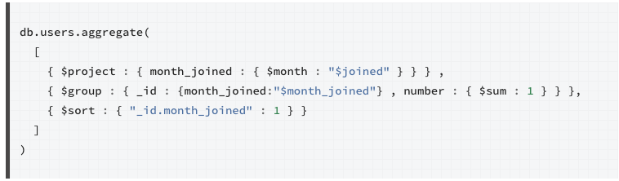
Amazon EC2: MongoDB
Aggregation pipeline filters down results naturally
Pairs with keywords from Alexa
Extremely fast querying from the DB

Slide 12
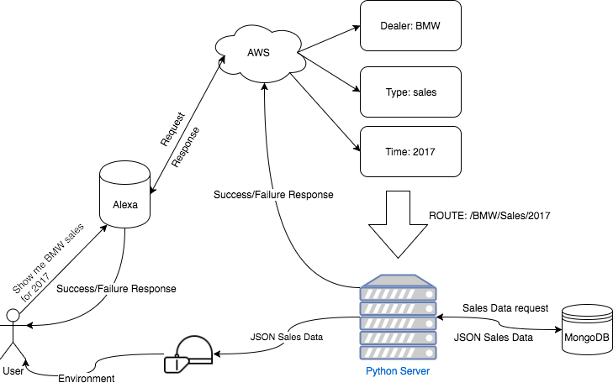
AWS EC2: Server
Server with route variables to specify what data is to be queried.
Websocket connectivity to only update headset if there is new data
Handles connecting the Alexa to the local VR headset
Modifiable for future use

Slide 13
Amazon Alexa: Machine Learning
Client requested non-robotic Alexa interactions
Currently contemplating either Python machine learning libraries
Or alternatively Amazon Lex
Follows same plug and play design as Alexa skills

